Slide 1
Cultivating Futures
Aullaaġvik and
University of Alaska Anchorage (UAA)
September 4, 2024

Slide 2
Agenda
Icebreaker
UAA Team Members
Kickstarting Success: Week 1 Classes
Q&A

Slide 3
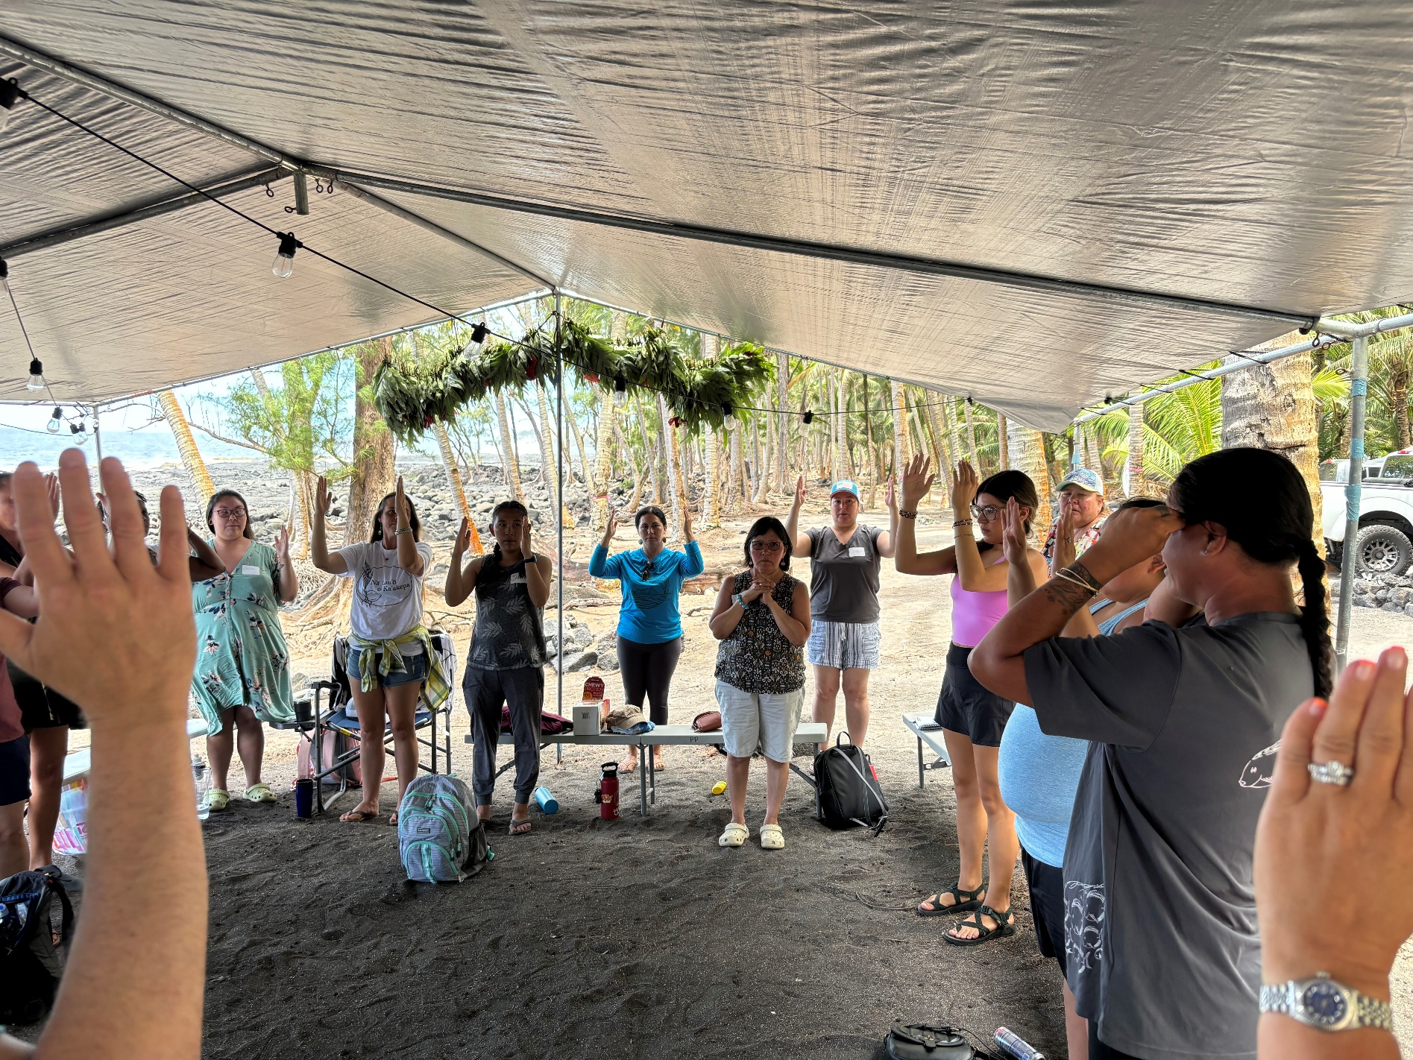
Icebreaker
If you could describe your first week of classes in a single emoji or word, what would it be, and why?

Slide 4
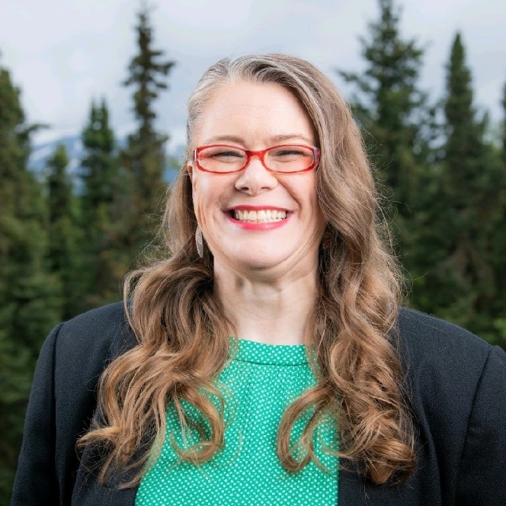
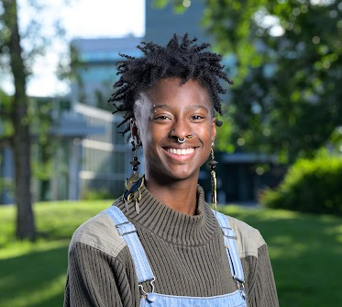
UAA Team Members
Darlene MacKinnon
Dr. Tonia A. Dousay
Sydney Stokes
Nicole Endsley
Student Success Coordinator
dlmackinnon@alaska.edu
Dean
School of Education
tadousay@alaska.edu
Student Placement
Outreach Specialist
sastokes3@alaska.edu
Apprenticeship and Accreditation Coordinator
naendsley@alaska.edu
Notes:
Please update the pictures and review the names, titles, and email addresses.

Slide 5
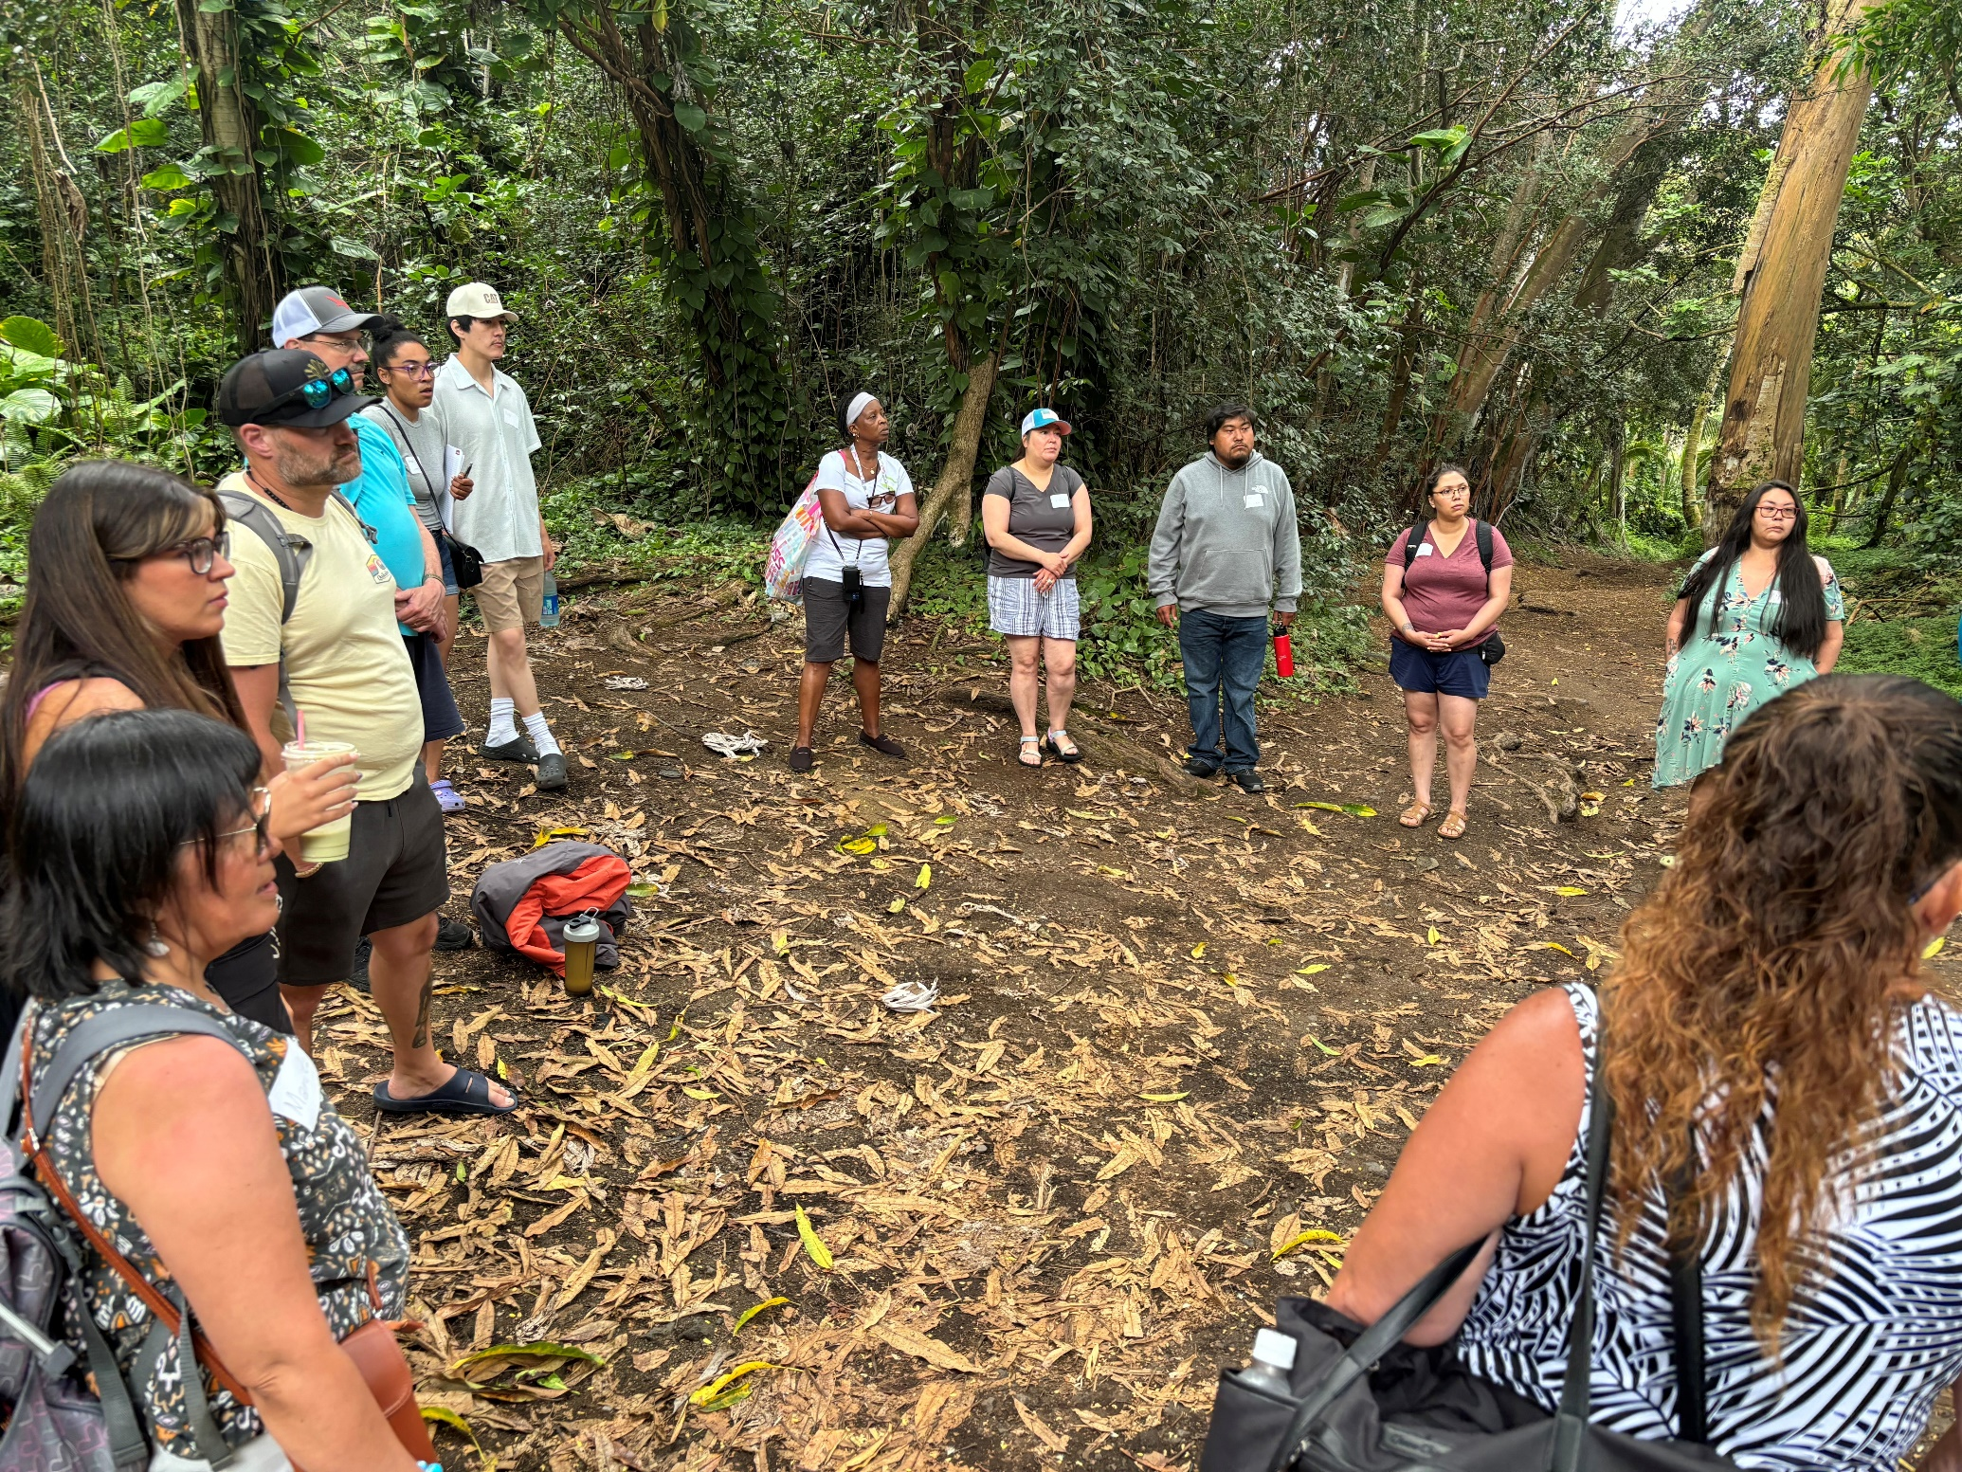
Kickstarting Success: Week 1 Classes
Highlights
All students are registered for the first 8-week Fall courses.
Positive feedback from instructors regarding apprentices’ involvement and enthusiasm.
Active participation in group activities and peer-to-peer learning.
Notes:
Please add more program highlights here.

Slide 6
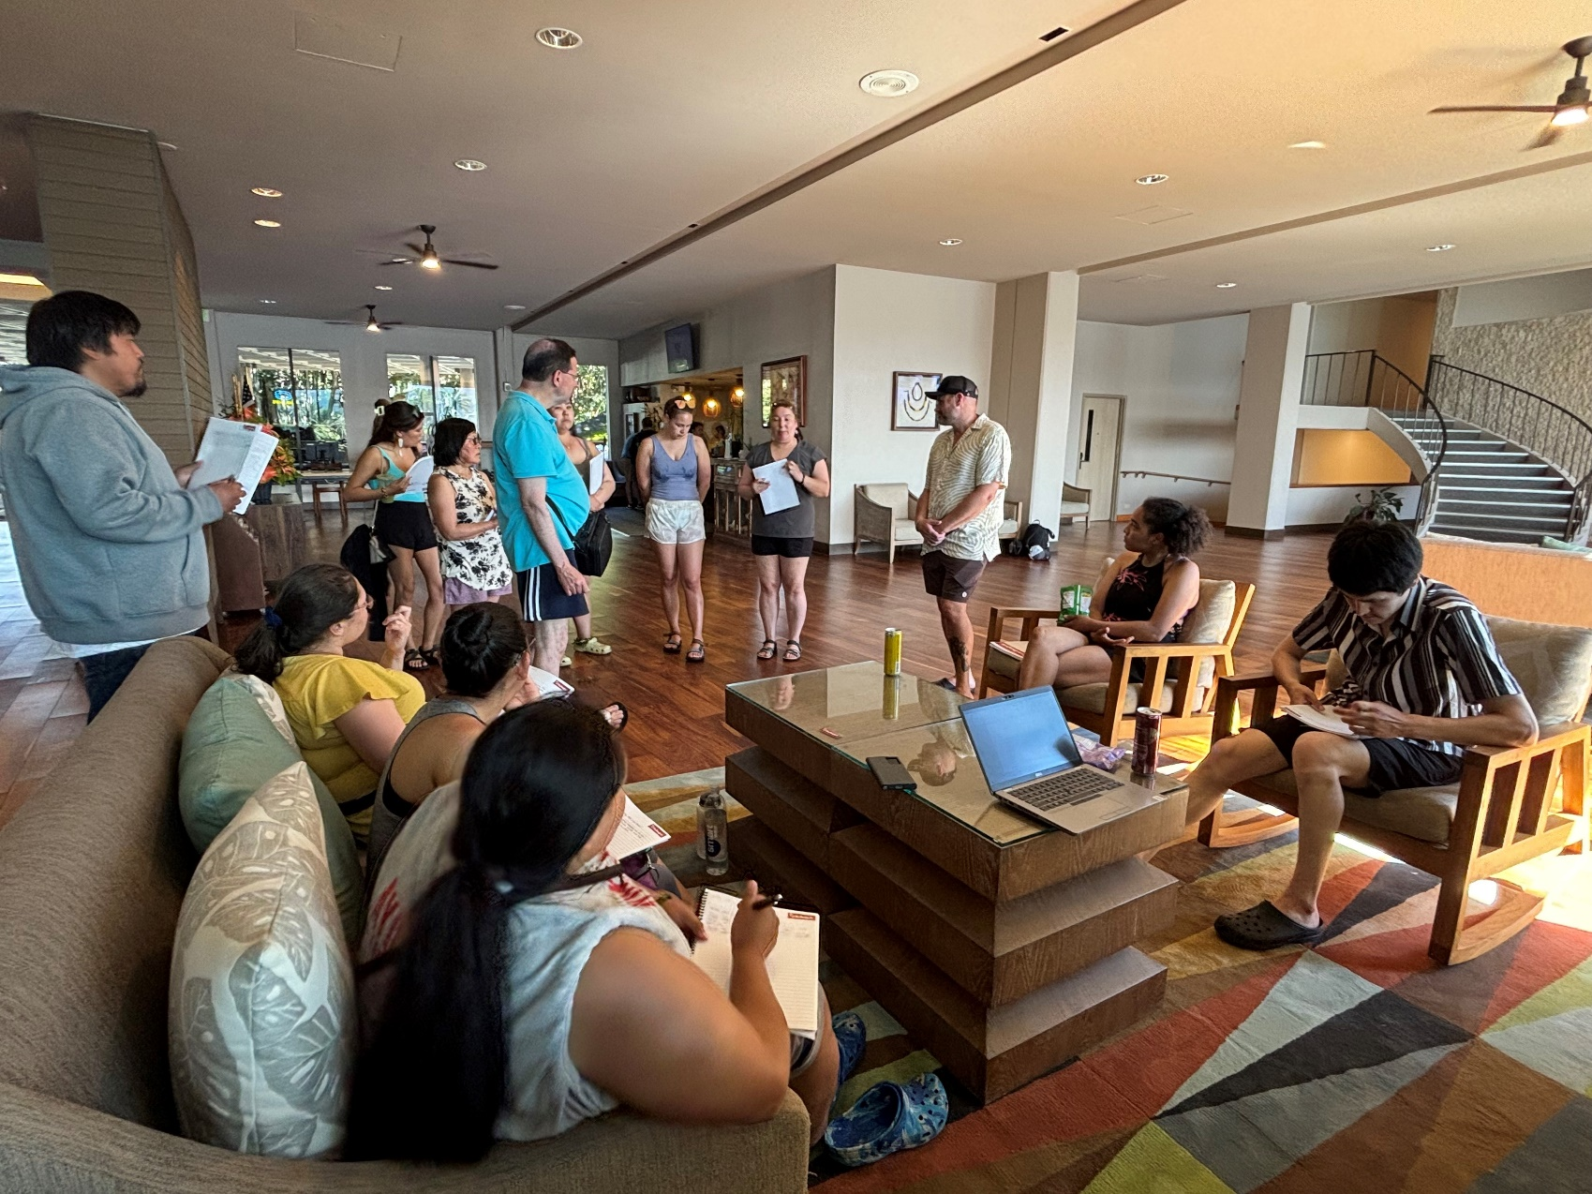
Q&A
What questions do you have for the UAA team to set you up for success this week and beyond?

Slide 7
Thank You
Regularly monitor your email and GroupMe app for timely updates and vital information.

